Slide 1
E-SURVEY WEB APPLICATION

Slide 2

TEAM
2200090255 - P.MOKSHITHA
2200032191 - C.SRI CHARAN
2200032615 - R.SHASHANK

Slide 3

INTRODUCTION
Welcome to E-Survey, the ultimate web application for
all your survey needs! With E-Survey, you can easily
create and conduct surveys with just a few clicks.
Whether you're conducting market research, gathering
customer feedback, or organizing an event, E-Survey
has got you covered.

Slide 4

WHY E-SURVEY IS THE BEST CHOICE FOR YOUR SURVEY NEEDS
E-Survey is not your average survey tool. With its advanced analytics and reporting capabilities, you can gain valuable insights into your data like never before. Our intuitive interface makes it easy to create and distribute surveys, and our customizable templates ensure that your surveys look professional and on-brand.

Slide 5
WHAT LANGUAGES REQUIRED TO CREATE E-SURVEY WEB APPLICATION
HTML/CSS: These are essential for creating the structure and styling of your web pages. HTML is used for structuring the survey questions and forms, while CSS is used for styling and layout.
JavaScript: JavaScript is crucial for adding interactivity to your survey application. You'll use it for tasks like validating user input, showing/hiding questions based on responses, and submitting data without refreshing the page (AJAX).
Backend Language: You need a server-side programming language to handle data storage, user authentication, and the business logic of your survey application. Common choices include:
Python: Using frameworks like Django or Flask.
Ruby: Using Ruby on Rails.
Node.js: Using frameworks like Express.js.
PHP: Using frameworks like Laravel or Symfony.
Java: Using frameworks like Spring.

Slide 6
HOW E-SURVEY WORKS
E-Survey is a user-friendly web application that simplifies the process of conducting surveys. Here's how it works:
Step 1: Create your survey by selecting from a variety of question types and customizing the design to match your brand.
Step 2: Share your survey with your target audience via email, social media, or embed it on your website.
Step 3: Collect responses in real-time and analyze the results using E-Survey's powerful reporting tools.
Step 4: Use the insights gained from your survey to make data-driven decisions and improve your business strategy.

Slide 7

BENEFITS OF USING E-SURVEY
E-Survey offers a range of benefits for conducting surveys.
Firstly, it provides a user-friendly interface that makes survey creation and management easy and intuitive. With E-Survey, you can create custom surveys in minutes, without any coding or technical knowledge required.

Slide 8
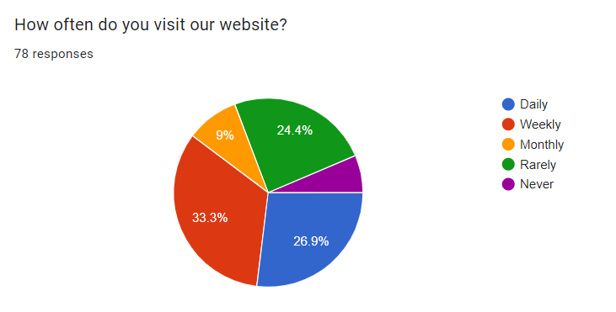
USER SURVEY

Slide 9
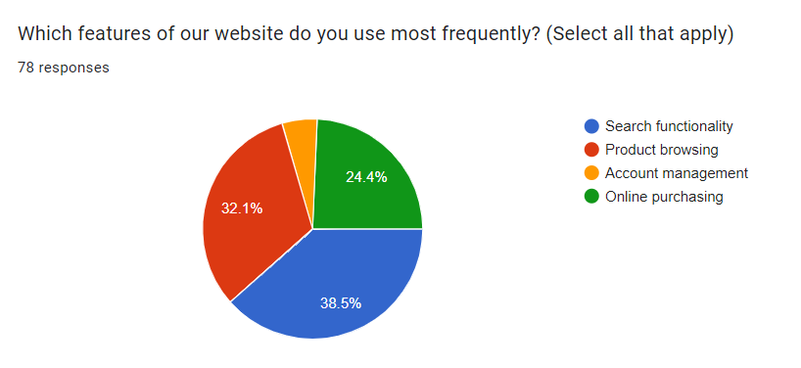
USER SURVEY

Slide 10
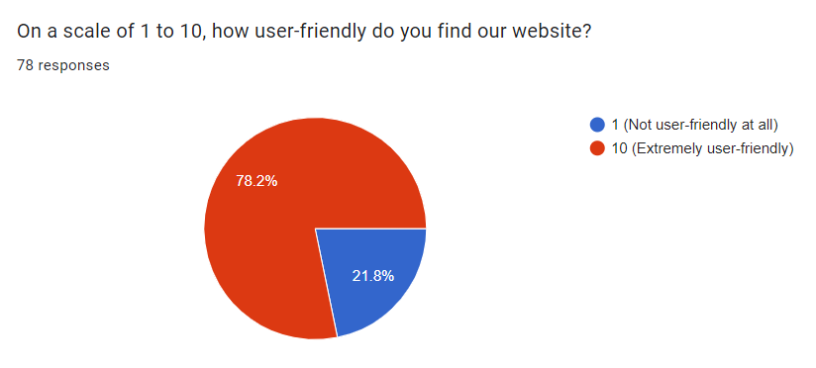
USER SURVEY

Slide 11
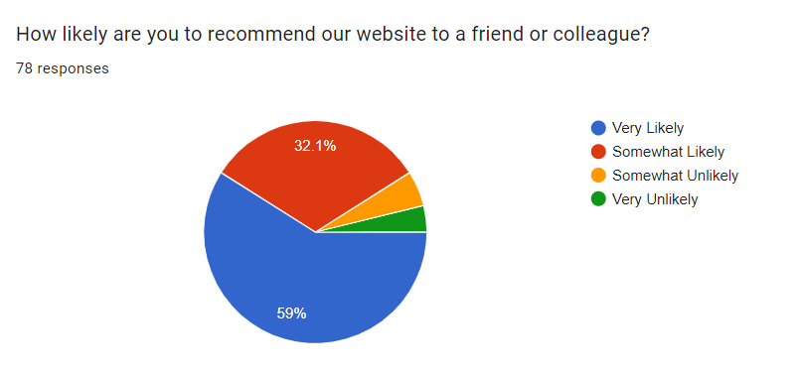
USER SURVEY

Slide 12

CUSTOMER SUCCESS STORIES
One of our clients, a non-profit organization, used E-Survey to conduct a survey on public opinion about their cause.
With E-Survey's customizable templates and user-friendly interface, they were able to create a professional-looking
survey in no time. They received an overwhelming response from the public and were able to use the data collected to further their cause.

Slide 13
GET STARTED WITH E-SURVEY TODAY
Don't miss out on the opportunity to streamline your survey process and gather valuable insights with E-Survey. Sign up today to start creating surveys that deliver results.
With E-Survey, you'll have access to a comprehensive suite of features designed to make survey creation and analysis easier than ever before. From customizable templates to real-time reporting, our platform has everything you need to get the job done.

Slide 14

DATA ANALYSIS AND REPORTING
Data analysis and reporting are crucial components of e-surveys. By analyzing the data collected through surveys,businesses can gain valuable insights into customer preferences, behavior, and satisfaction levels.
Through data analysis, businesses can identify trends and patterns in customer feedback, which can help them make informed decisions about product development, marketing strategies, and customer service initiatives.

Slide 15

CONCLUSION
In conclusion, e-surveys offer numerous benefits over traditional survey methods. They are cost effective, convenient , and can reach a larger audience in a shorter amount of time. By using e-survey web applications , businesses can create customized surveys with ease and analyze data quickly and efficiently.

Slide 16


